Slide 1
Journal Club August 23,2020
BALANCE Trial
Kevin Ha, PGY1
UT Health San Antonio, Psychiatry
Notes:
Bipolar Affective disorder Lithium ANticonvulsant Evaluation (BALANCE)

Slide 2
Why this paper
Large, multi-center trial with diverse patient pool
Aimed to simplify outcome measurements, allowed for clinician decision making
Three-group study testing combination vs monotherapy alone
Specifically looked at relapse prevention/maintenance tx

Slide 3
Background and Application of study
Lithium = standard maintenance tx w/ evidenced risk reduction of relapse & suicide
  Narrow therapeutic index
  Suboptimum adherence 2/2 side effect profile
Noticeable outpatient uptrend of Valproate prescriptions vs downtrend of Lithium prescriptions
  Yet many people do not respond to monotherapy
Clinical Question: Is Li+VPA combination better than monotherapy in the prevention of relapse in patients with Bipolar I disorder?

Slide 4
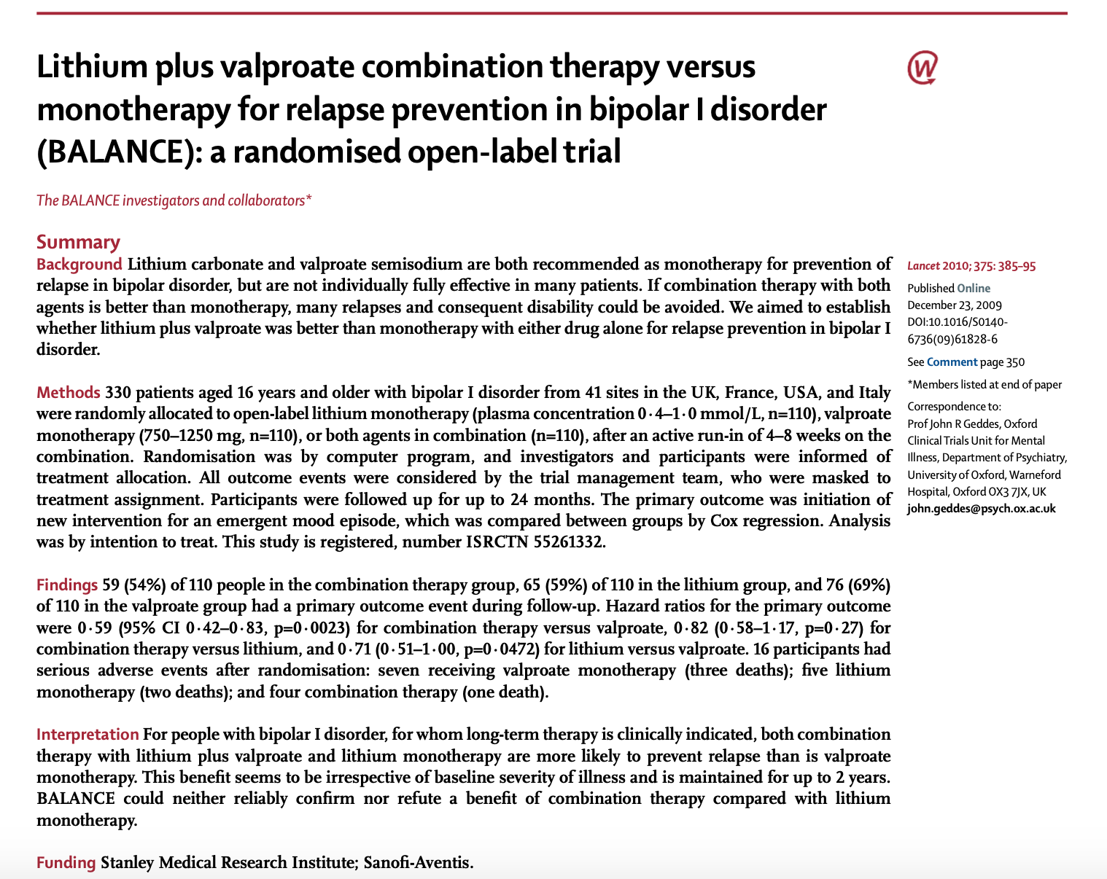
Notes:
Bipolar Affective disorder Lithium ANticonvulsant Evaluation (BALANCE)

Slide 5
Methods
“Randomized, open-label, three-group trial of maintenance therapy, w/ up to 24 months of follow-up”
Recruitment: May 2001- February 2007
  UK, USA, Italy, France @ 41 different clinical sites
Inclusion Criteria for initial “Run-in Phase”
  16 yo, DSMIV Dx of Bipolar I DO
  Written consent
  Not in acute mood episode
  Clinician decided indication for long-term maintenance
  Clinician decided indication for combination therapy
  No contraindications (e.g. pregnancy)
  Resident in state of testing

Slide 6
Methods
Active “Run-In” phase
  4-8 weeks of combination tx, designed to establish participants included in randomization phase
  Aimed to
    ID participants with clear preference for tx -> exclude from randomization
      To minimize risk of performance and ascertainment biases
    Establish [Li] of 0.4-1.0
    Establish VPA dosing of at least 750mg (goal of 1250mg) or [VPA] >50
      OK to be at higher doses if already on previously
      OK for lower doses if [VPA] >50
    Establish medication tolerance
    Establish treatment adherence (goal of 70% as judged by clinician)
Notes:
Performance bias: differences that occur due to knowledge of interventions allocation, in either the researcher or the participant.
Ascertainment bias generally refers to situations in which the way data is collected is more likely to include some members of a population than others.

Slide 7
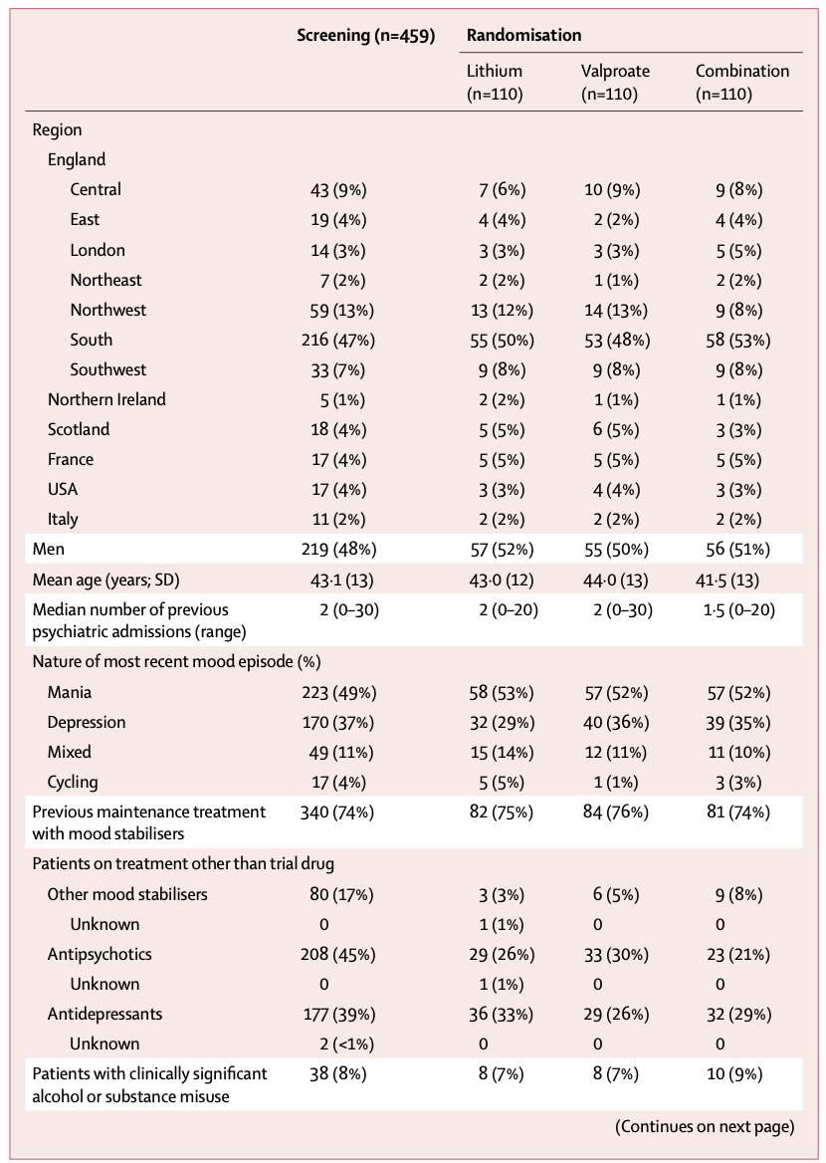
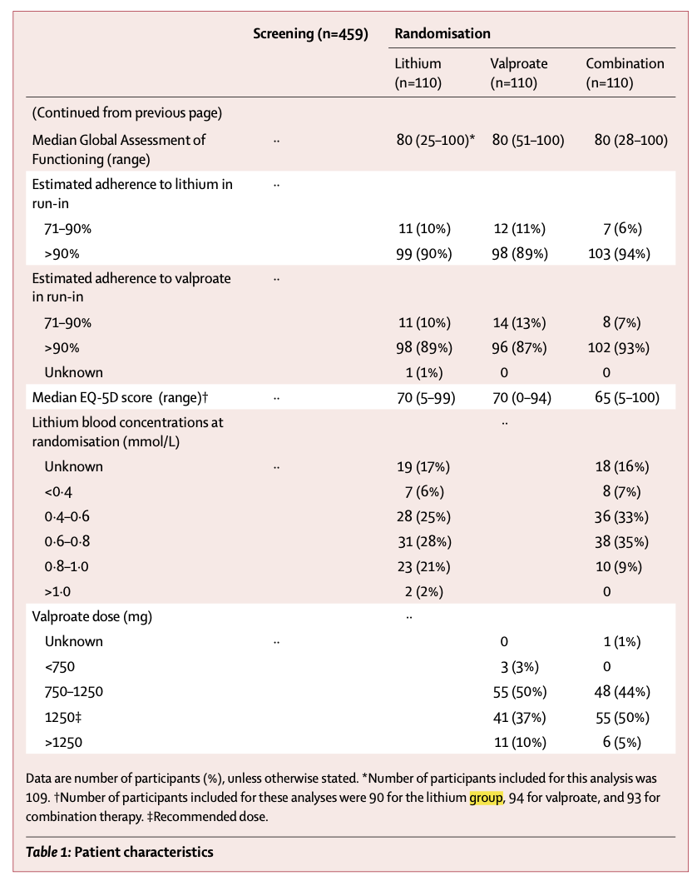
Methods: Randomization
Notes:
Pt with clinically significant alcohol or substance misuse
The proportion of participants with substance-misuse comorbidity (8%) was lower than that reported from population surveys. This finding probably mirrors differences in case ascertainment—in BALANCE the investigator was asked only to record whether they considered substance or alcohol use to be a clinically significant problem, whereas in population surveys, evidence of substance misuse is sought through structured interview.

Slide 8
Methods: Randomization
After “Run-In” randomized into
  Continuation of combination therapy
  Lithium monotherapy (VPA withdrawn slowly over four weeks to minimize relapse risk)
  VPA monotherapy (Li withdrawn slowly over four weeks to minimize relapse risk)
Serum [Li] drawn at time of randomization
Patients followed for two years or until treatment failure
  End of trial QoL questionnaire

Slide 9
Primary Outcome
  Time to new intervention for an emerging mood episode
    Start of new medication
    Increase in dosage of concurrent non-study medications
    Restarting a previously discontinued concurrent medication
    Increased investigational dosage for emergent mood episode
    Hospital admission
Secondary Outcomes
  Time to new intervention for MDE/Manic episode
  Global assessment of functioning
  DSH (episodes of deliberate self-harm)
  QD-5D (quality of life questionnaire)
  Serious AE and pt reported AE
  Withdrawal from treatment
  Adherence to treatment estimated by investigator
Notes:
Initial 1˚ outcome was time until hospital admission; however want to broaden scope

Slide 10
Statistical Models
To obtain 90% power at two-tailed 5% significance level to detect 40% relative reduction in hazard from an expected value of 70% on the assumption of a 20% drop-out from tx
  N= 231
To detect a 40% reduction in hazard ration for a depressive episode requiring new tx with 80% power at 5% significance level
  Need n=345 with each group n=115
Time from randomization -> event summarized by Kaplan-Meier curves and compared with the log rank test
Notes:
Power = probability of rejecting null that is false
AKA ability to pick up an effect that is present
Two-Tailed Test = used for null hypothesis testing for statistical significance
5% means split to lower 2.5 and upper 2.5 -> any data points above upper or below lower = out of acceptance range and is rejected

Slide 11
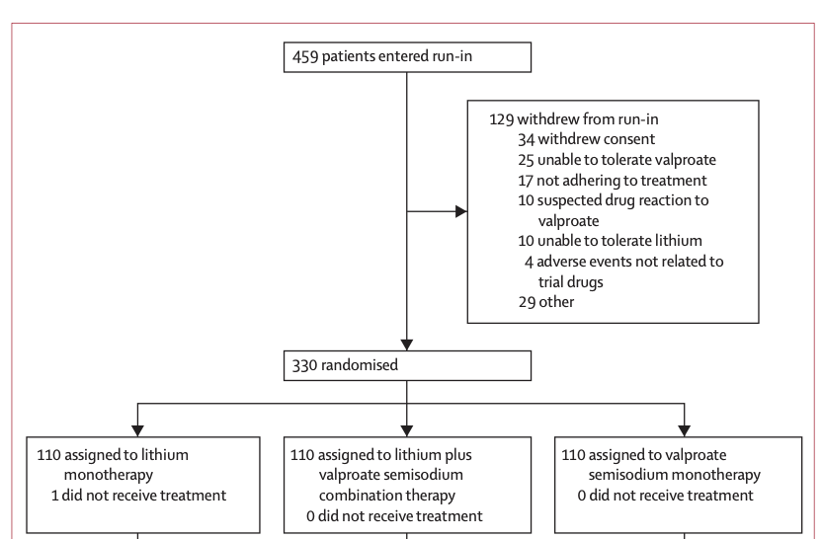

Slide 12
Results
“Run-In” Phase n=459
  129 withdrew
  ** 221 of 414 UK patients received Lithium titration initiation vs 296 received VPA titration initiation = more participants were already on Li compared to VPA
Randomization phase n = 330
  Combination Tx: n = 110
  Li only Tx: n = 110
  VPA only Tx: n = 110
Participants followed for 589.8 person years
  201.1 person years under combination tx
  191.6 person years under Li tx
  197.2 person years under VPA tx
Participants who remained on allocated tx for 452.6 person years
  155.1 person years under combination tx
  1149.0 person years under Li tx
  148.5 person years under VPA tx

Slide 13
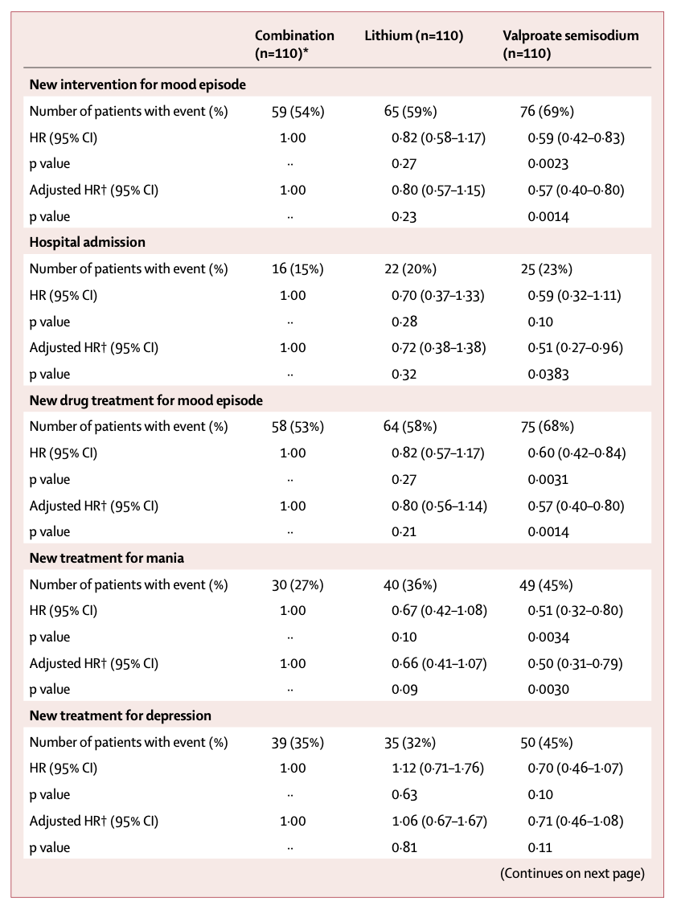
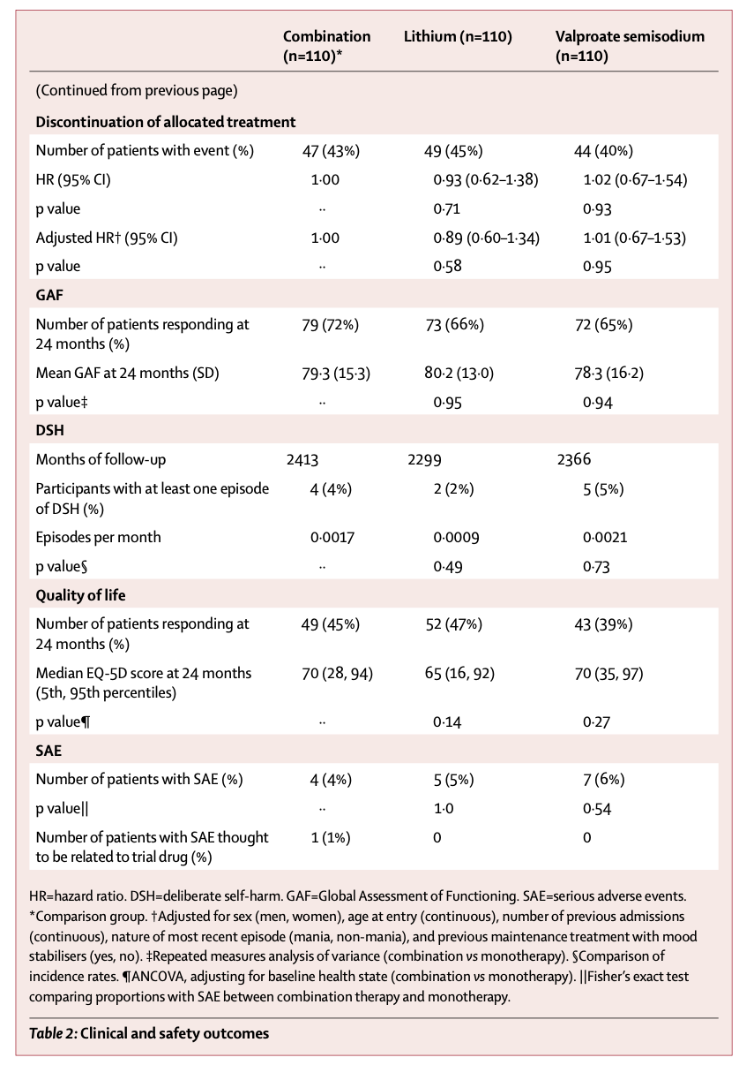
Notes:
During the follow-up period the primary outcome
- 59 of 110 (54%) of participants on combination therapy
- 76 of 110 (69%) on valproate semisodium
- 65 of 110 (59%) on lithium carbonate (table 2 and figure 2).
The hazard of the primary outcome was significantly lower than for participants allocated to combination therapy than for those allocated to valproate monotherapy, but not lower than for those allocated to lithium monotherapy (table 2).
Hospital admission
Adjusted HR lower in Combination than VPA
P of 0.0383
New drug tx for mood episode
Adjusted and non-adjusted significantly lower in Combination than VPA
New tx for mania
Adjusted stat sig lower in Combination than VPA
New tx for depression
Combination not statistically significant in combination vs mono
However, Li monotherapy had some less than even combination
No stat diff in DCm, self harm, QoL, Global Function

Slide 14
Significant Side Effects
Run-In Phase: 5 participants
After Randomization: 16 participants
  VPA: 7
    Three deaths (stroke, peritonitis, carcinoma bronchus)
  Li: 5
    Two deaths (respiratory failure and bronchopneumonia)
  Combination
    One death (respiratory failure)
No suicides occurred
Five women became pregnant during trial (2 during run-in; 3 after randomization)
Most participants who responded reported at least one non-serious SE
  VPA: 48/52
  Li: 52/55
  Combination: 57/57

Slide 15
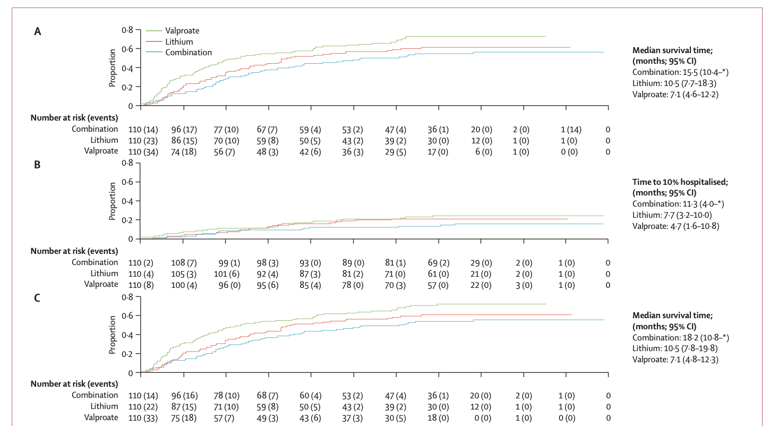
Notes:
X Axis = Time in Mo
Y Axis = Proportion of event
A: First admission OR start of adjuvant tx for mood
B: First admission
C: First adjuvant tx added for mood

Slide 16
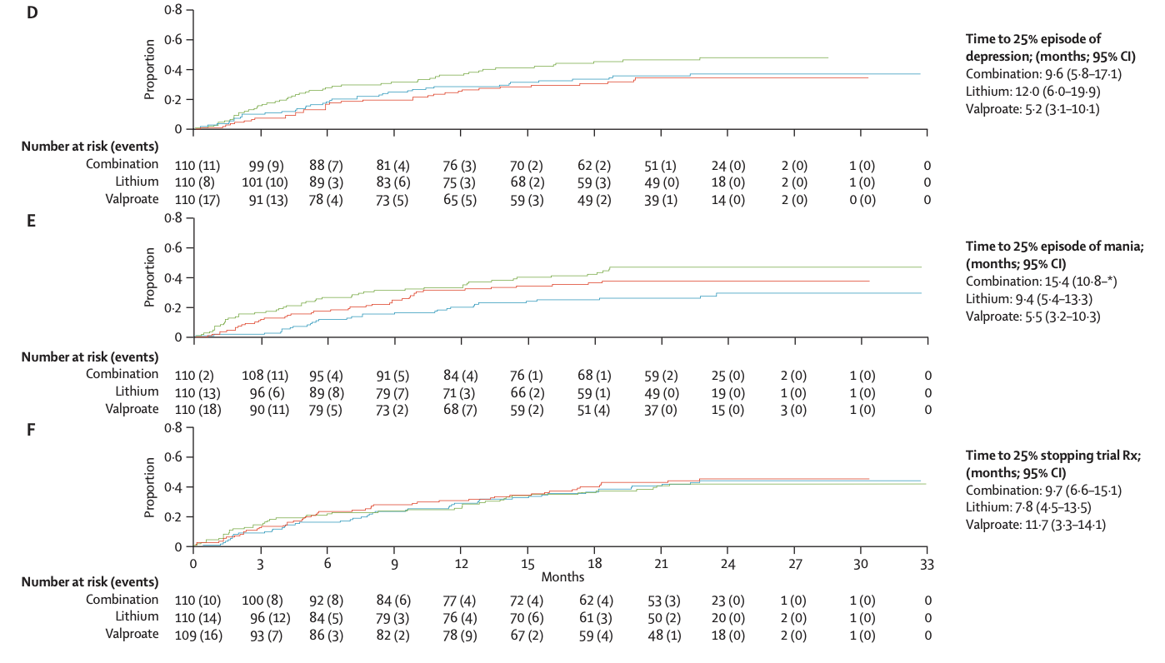
Notes:
X Axis = Time in Mo
Y Axis = Proportion of event
D: 1st MDE
- Notice that Li tx had better time to first MDE than even combination tx
E: 1st Manic Episode
F: Stopping trial treatment

Slide 17
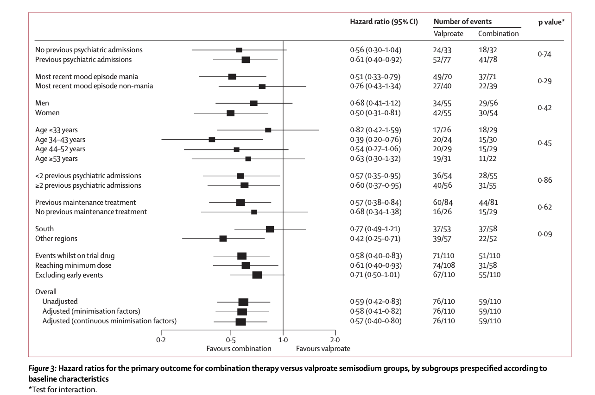

Slide 18
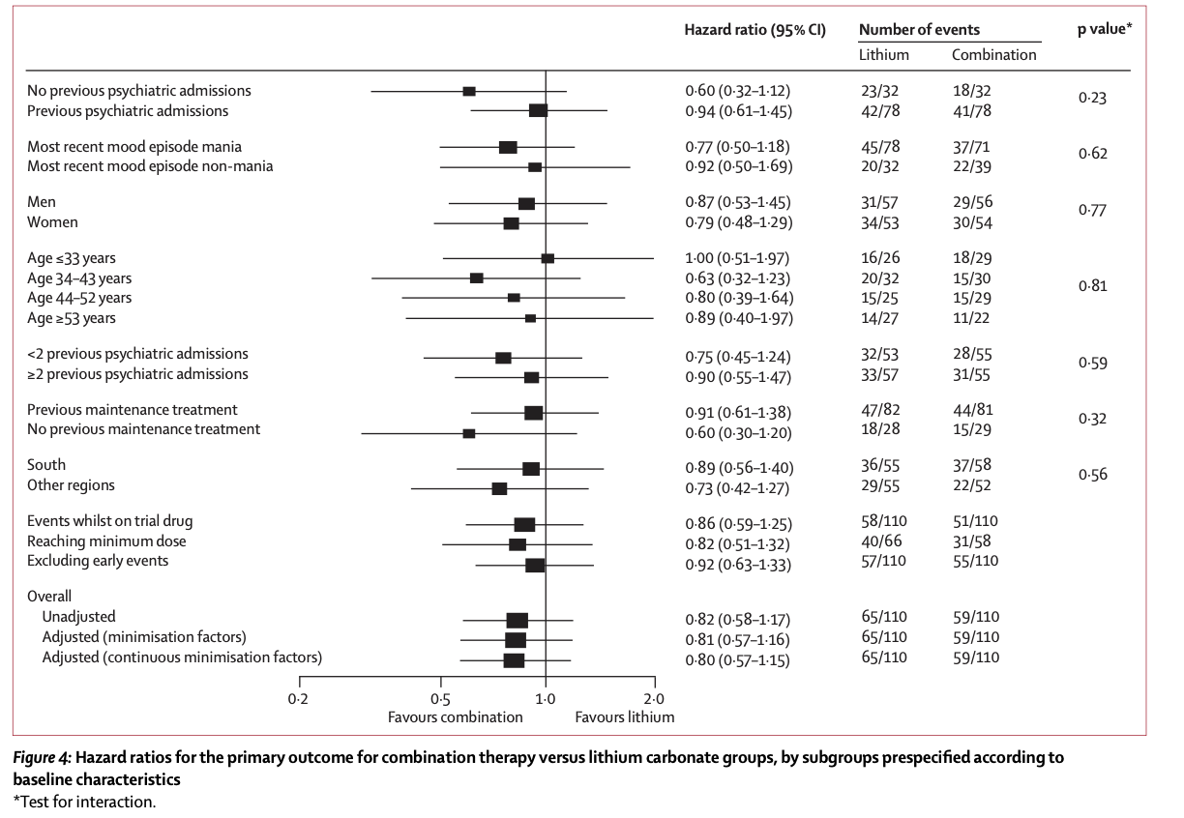

Slide 19
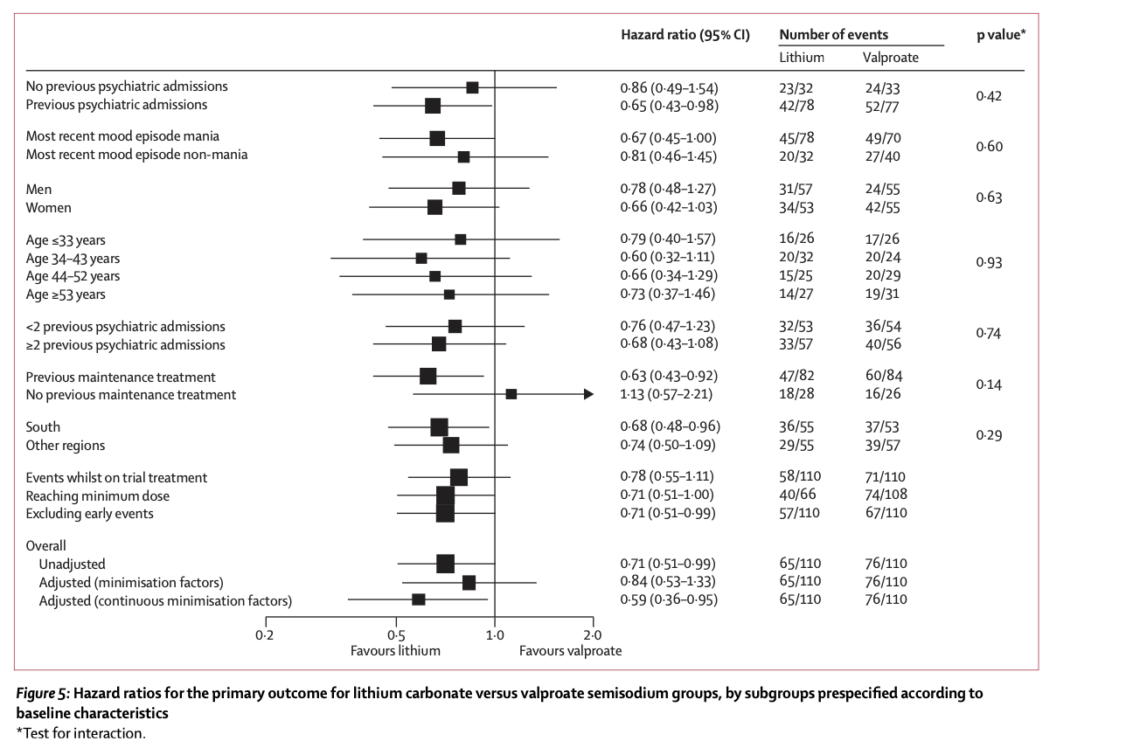

Slide 20
Discussion
The results of BALANCE show that for people with bipolar I disorder for whom long-term therapy is clinically indicated, combination therapy with lithium plus valproate is more likely to prevent relapse than is monotherapy with valproate.
Could not confirm/refute combination tx cs Li monotherapy
15.5% difference in risk bw combination tx and VPA monotherapy
  NNT = 7
10% difference in risk bw VPA and Li monotherapies
  NNT = 10
Non-significant 5.5% difference in risk bw combination and Li monotherapy
  NNT =19
Notes:
The Number Needed to Treat (NNT) is the number of patients you need to treat to prevent one additional bad outcome.
NNT= 1/ARR
ARR = [(C/C+D)] - [(A/A+B)]

Slide 21
Study Weaknesses
Open label
  Risk of performance and ascertainment biases
  Tried to reduce by excluding pt w/ clear preference
Clinician Dependence
  Exclusion Criteria of acute episode; no systematic way of determining
  1˚ intervention of new mood episode
21% of patients withdrew before 24 months
  Most patients withdrew 2/2 intolerance
Suboptimal [Li] compared to clinical practice
Lower VPA dosage than normal

Slide 22
Conclusion
“Our results suggest that patients should be advised that a better outcome would be likely with combination therapy with lithium plus valproate semisodium or lithium alone. Second, guidelines suggest that patients who have frequent relapses during treatment with lithium monotherapy could switch to valproate monotherapy.5 The results of BALANCE suggest that these patients would fare better if they changed to combination therapy.”

